Slide 1
High Dimensional Data and Dimensionality Reduction
(What it means and why it isn’t scary)

Slide 2
Outline
High dimensional or n-dimensional data
Applications
Principal Component Analysis (PCA)
Basics in R

Slide 3
Dimensionality in Biological Data
Dimensionality – the number of attributes in a dataset (measurements – m)
Number of samples - n
Represent the data in a matrix – X=(m x n)
For example:
1 measurement (m)/sample for 1000 samples (n=1000) -> 1 dimension (1x1000)
34 measurements/sample for 300 samples -> 34 dimensions (34x300)
Big data = lots of numbers =/= high dimensional
Notes:
TYPO REMOVE OR
ITS M ROWS AND N COLUMNS RIGHT?

Slide 4
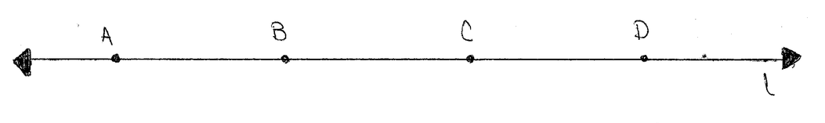
Dimensionality in Biological Data
Why dimensions?
How do we represent differences between samples in a dataset visually?
Expression of one transcript across several samples
One dimension

Slide 5
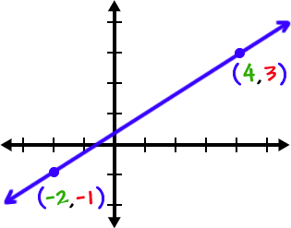
Dimensionality in Biological Data
How do we represent differences between samples in a dataset visually?
Expression of one transcript across several samples
Expression of two transcripts across several samples

Slide 6
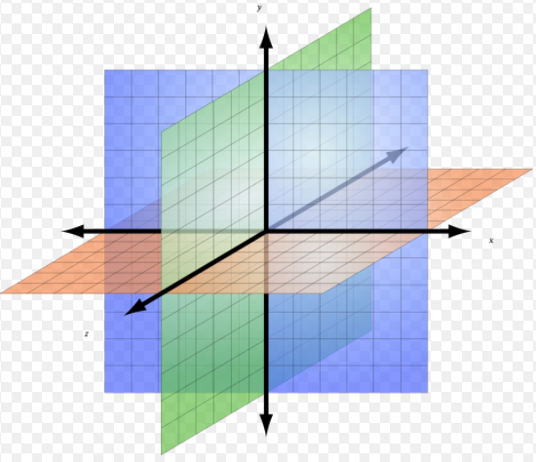
Dimensionality in Biological Data
Challenge – how do we represent differences between samples in a dataset visually?
Expression of one transcript across several samples
Expression of two transcripts across several samples
Expression of three transcripts across several samples

Slide 7
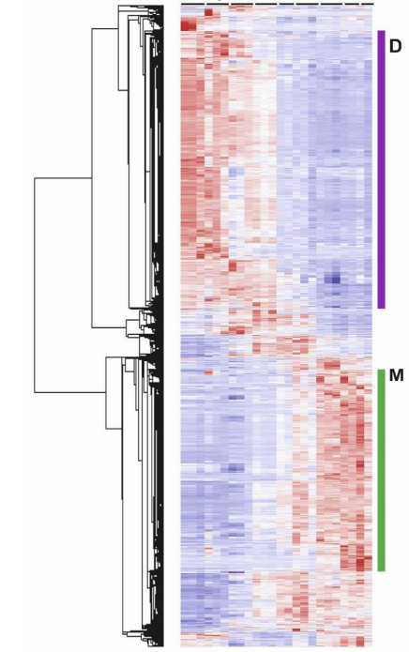
We Need to Simplify - Dimensionality Reduction
Samples (Time)
How do we plot something like this (thousands of points) more simply?
Curse of Dimensionality
Needs:
Visualize/Analyze
Simplicity (fewer values)
Fidelity to complete dataset
“Retain Variation” in the dataset
Genes
Knox et al. 2008

Slide 8
Principal Component Analysis (PCA)
Goals – Reduce dimensions so we can visualize, maintain variation
Method for identifying sources of most of the variation in a dataset (components)
Components do not have inherent meaning!
But we can assign them meaning based upon our experimental design
Longitudinal study w/ 1 treatment group and 1 control group
What are the expected sources of variation?
What might be confounding sources of variation?
Notes:
Talk about other sources of variation

Slide 9
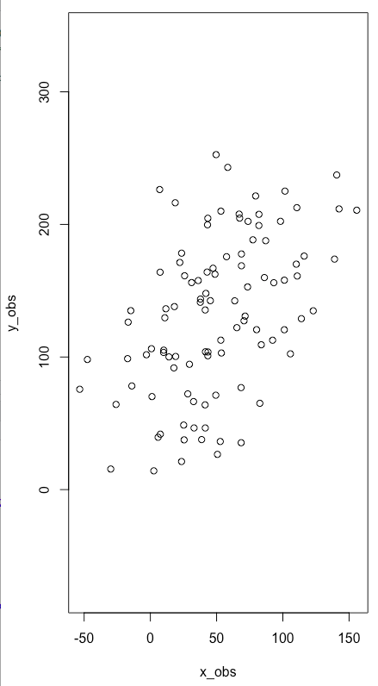
Principal Component Analysis (PCA) – 2D example
Reduce data to a linear projection that explains the most variation, Principal Component 1 (PC1)
If I had to explain this using one line, where would that line be?
Repeat this process with the linear projection that explains the second most variation (PC2)
Each PC is orthogonal (perpendicular)

Slide 10
Principal Component Analysis (PCA) – 2D example
Approximate PC1 and PC2
How many PCs can the 2D dataset on the right have?

Slide 11
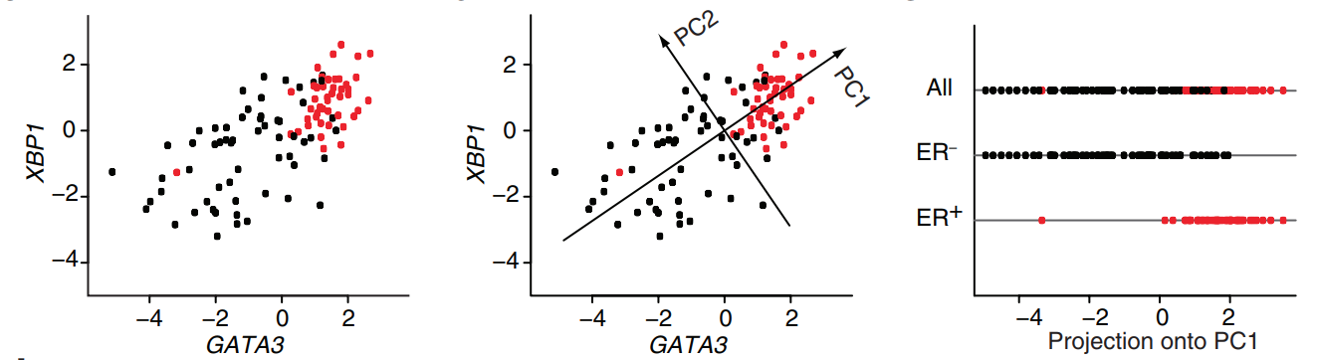
Principal Component Analysis (PCA) – 2D example

Slide 12
Common Applications
Finding patterns/correlations
Prediction
How alike are my samples?
Notes:
INTRODUCE DIMENSIONALITY REDUCTION

Slide 13
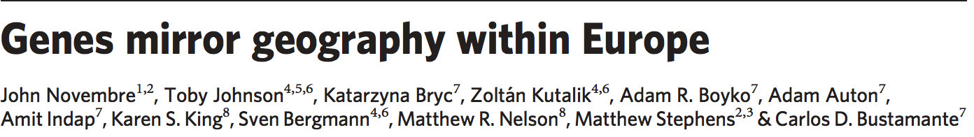
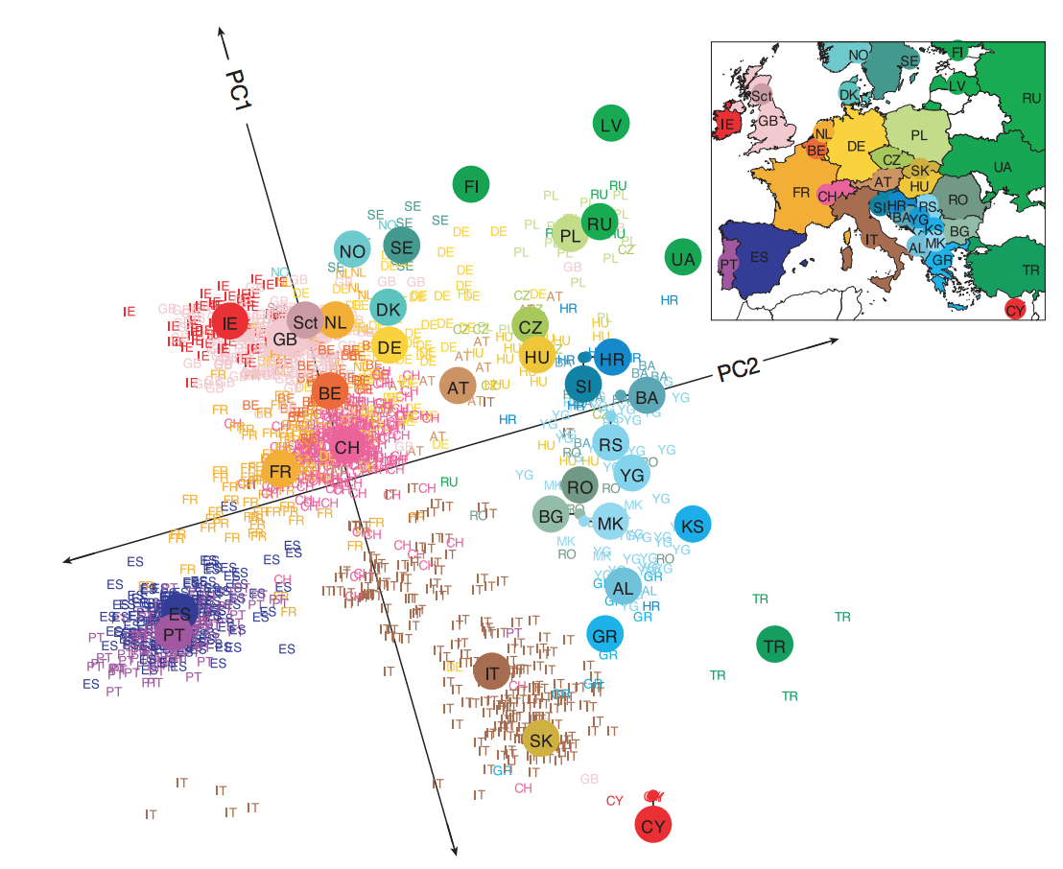
Common Applications
Data Matrix
m = ~500,000 snp loci
n = ~3000 people
X = (500,000x3,000)
Identify variables which separate the data
UW – Data4Bio https://www.youtube.com/watch?v=sIyMAzAHw6I

Slide 14
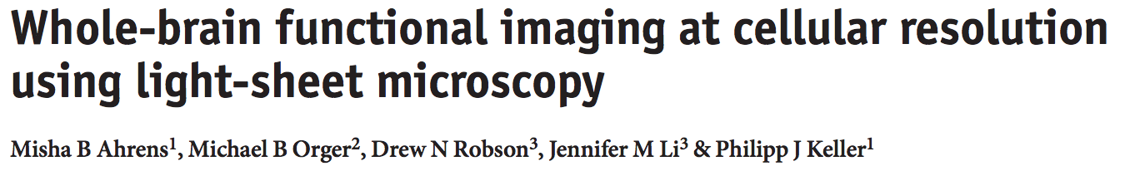
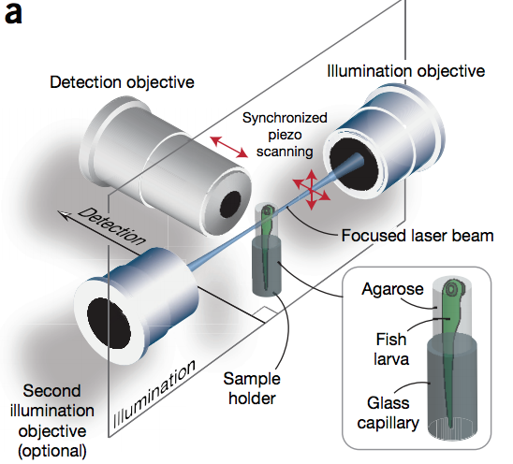
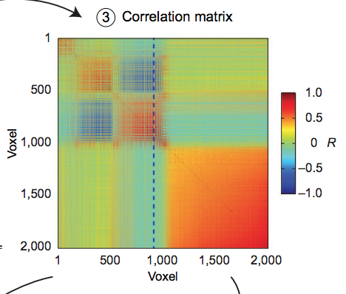
Common Applications
Data Matrix
m = 1/sec (3600/hr)
n = ~100,000 neurons
X = (3,600x100,000)
Identify patterns/correlations which mark neural connections
UW – Data4Bio https://www.youtube.com/watch?v=sIyMAzAHw6I

Slide 15
Practical R exercises
R resources
Calculating PCs with our 2D example
“Real World” Example of clustering samples

